Slide 1



Multimedia & Graphics
Class VI
lab 17

Slide 2


Making a Perfect Afternoon
Illustrate something like
that so that you can feel
this is a perfect afternoon
use clipart to find all the
necessary images

Slide 3

Making a Perfect Afternoon
Take a tree house

Slide 4
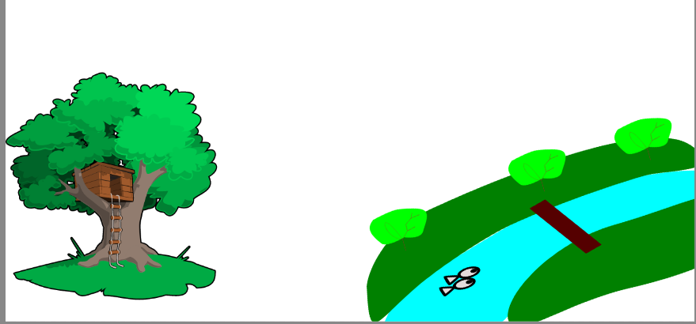
Making a Perfect Afternoon
Take river or lake

Slide 5
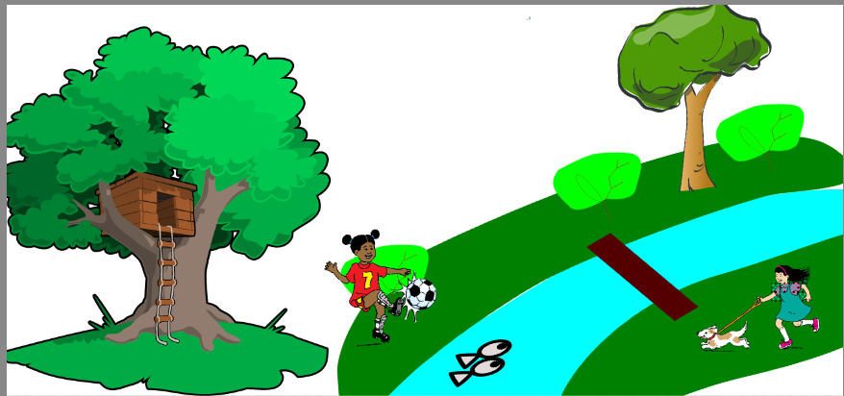
Making a Perfect Afternoon
choose some playing kids

Slide 6
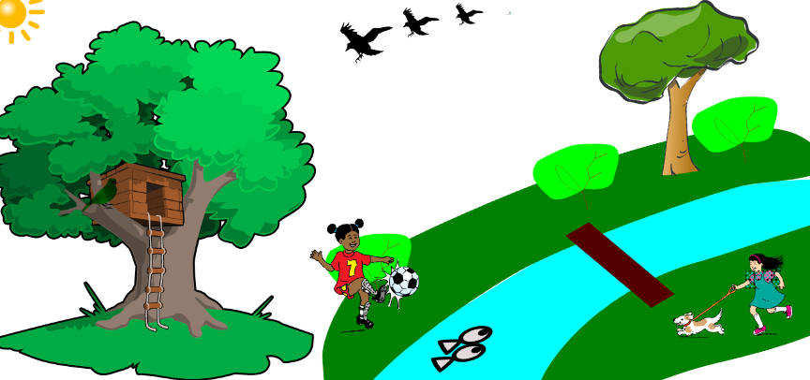
Making a Perfect Afternoon
add sun and birds then change the bakground

Slide 7
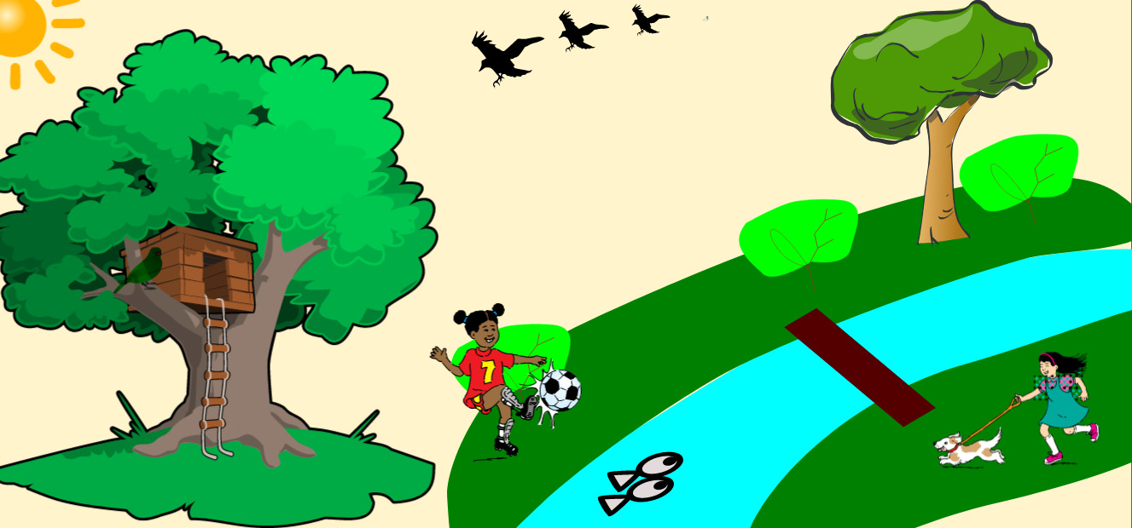
Making a Perfect Afternoon
here we go

Slide 8



